Slide 1

KS3 Mathematics
A1 Writing expressions
Notes:
The aim of this unit is to teach pupils to:
Use letter symbols and distinguish their different roles in algebra
Know that algebraic operations follow the same conventions and order as arithmetic operations; use index notation and the index laws
Simplify or transform algebraic expressions
Material in this unit is linked to the Key Stage 3 Framework supplement of examples pp 112-121.

Slide 2


Using symbols for unknowns
Look at this problem:
+ 9 = 17
The symbol
stands for an unknown number.
We can work out the value of .
= 8
because
8 + 9 = 17
Notes:
Introduce the idea of using symbols to represent unknowns in mathematics.

Slide 3
Using symbols for unknowns
Look at this problem:
–
= 5
The symbols
and
stand for unknown numbers.
In this example, and can have many values.
For example,
12 – 7 = 5
or
3.2 – –1.8 = 5
and
are called variables because their value can vary.

Slide 4
Using letter symbols for unknowns
In algebra, we use letter symbols to stand for numbers.
These letters are called unknowns or variables.
Sometimes we can work out the value of the letters and sometimes we can’t.
For example,
We can write an unknown number with 3 added on to it as
n + 3
This is an example of an algebraic expression.

Slide 5
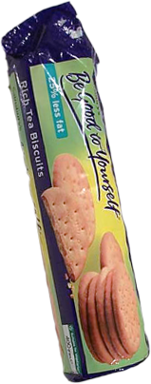
Writing an expression
Suppose Jon has a packet of biscuits and he doesn’t know how many biscuits it contains.
He can call the number of biscuits in the full packet, b.
If he opens the packet and eats 4 biscuits, he can write an expression for the number of biscuits remaining in the packet as:
b – 4
Notes:
Talk through the example. Stress that b stands for the number of biscuits in the full packet. We could choose any letter to stand for the unknown number. We chose b because b stands for biscuit. We could also have n for number or any other letter.
Stress that the expression b – 4 describes the relationship between the number of biscuits in the full packet and the number of biscuits in the packet after 4 biscuits have been eaten.
For example, if there were 20 biscuits in the original packet, then there are 20 – 4 = 16 biscuits after 4 biscuits have been eaten. If there were 32 biscuits in the original packet, then there are 32 – 4 = 28 biscuits after 4 biscuits have been eaten.

Slide 6
Writing an equation
Jon counts the number of biscuits in the packet after he has eaten 4 of them. There are 22.
He can write this as an equation:
b – 4 = 22
We can work out the value of the letter b.
b = 26
That means that there were 26 biscuits in the full packet.
Notes:
Stress the difference between an expression and an equation. An expression does not contain an equals sign.
In an equation we can often work out the value of the letter symbol. In an expression we cannot.

Slide 7
Writing expressions
When we write expressions in algebra we don’t usually use the multiplication symbol ×.
For example,
5 × n or n × 5 is written as 5n.
The number must be written before the letter.
When we multiply a letter symbol by 1, we don’t have to write the 1.
For example,
1 × n or n × 1 is written as n.
Notes:
Introduce these algebraic conventions.
When we write an algebraic expression we try to use as few numbers, letters and symbols as necessary. If we know that 5n means 5 lots of n, then we don’t need to write 5 × n.
You may like to mention that leaving out the multiplication sign × avoids confusing it with the letter symbol x which is often used in algebra.
You may also like to stress to pupils that when they write the letter x in algebra it should be written in script form to distinguish it from a multiplication sign.

Slide 8
Writing expressions
When we write expressions in algebra we don’t usually use the division symbol ÷. Instead we use a dividing line as in fraction notation.
For example,
n
n ÷ 3 is written as
3
When we multiply a letter symbol by itself, we use index notation.
For example,
n squared
n × n is written as n².
Notes:
Tell pupils that n² is read as ‘n squared’ or ‘n to the power of 2’.

Slide 9
Writing expressions
Here are some examples of algebraic expressions:
n + 7
a number n plus 7
5 – n
5 minus a number n
2n
2 lots of the number n or 2 × n
6
6 divided by a number n
n
4n + 5
4 lots of a number n plus 5
a number n multiplied by itself twice or n × n × n
n³
3 × (n + 4) or 3(n + 4)
a number n plus 4 and then times 3.
Notes:
Explain that algebra is very much like a language. It follows special rules, like the rules of grammar in a language. We have to keep to these rules so that any mathematician in the world can understand it.
Algebra is very important in mathematics because it describes the relationships between numbers.
Explain that there is a difference between an unknown and a variable. An unknown usually has a unique value which we can work out given enough information. A variable can have many different values.
We can use any letter in the alphabet to stand for unknowns or variables but some letters are used more than others. For example, we often use a, b, n, x or y. But we try not to use o (because it looks like 0).
Explain that in algebra we do not need to write the multiplication sign, ×, and so 2 lots of n is written as 2n. 3 lots of a, or 3 times a would be written as 3a. 5 lots of t, or 5 times t would be written as 5t.
Give some examples of possible values for 2n. If n is worth 5 then 2n is equal to 10 (not 25). If n is worth 20 then 2n is worth 40.
When we divide in algebra we write the number we are dividing by underneath, like a fraction. In this example, if n was worth 2, 6/n would be equal to 3.
Tell pupils that n³ is read as ‘n cubed’ or ‘n to the power of 3’. Give some examples, if n is worth 2 then n³ is 2 × 2 × 2, 8.

Slide 10
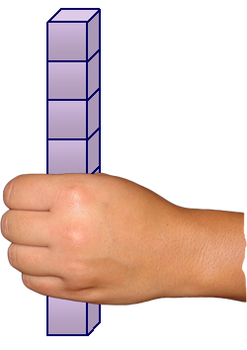
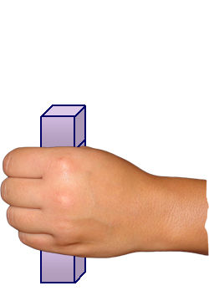
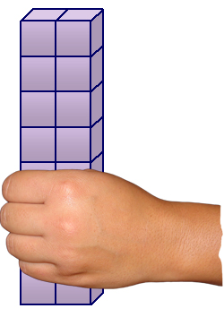
Writing expressions
Miss Green is holding n number of cubes in her hand:
Write an expression for the number of cubes in her hand if:
She takes 3 cubes away.
n – 3
She doubles the number of cubes she is holding.
2 × n
or
2n
Notes:
Discuss the examples on the slides and give other examples from around the classroom.
For example,
Suppose Joe has p number of pencils in his pencil case. If Harry, sitting next to him, gives him two more pencils, what expression could we write for the number of pencils in his pencil case? (p + 2)
We don’t know what p is (without counting) but we can still write an expression for the number of pencils in the case.
If p, the original number of pencils in the pencil case was 9, Joe would now have 11. If p was 15, Joe would now have 17.
Now, Joe gives Harry back his pencils, so he has p pencils again. Suppose he shares his pencils equally between himself and two of his friends. How many pencils will they have each? (p ÷ 3)
Tell pupils that if they are not sure whether or not an expression works, they should try using numbers in place of the letters to check. For example,
If Joe had 18 pencils and shared them between himself and his 2 friends they would get 6 each, 18 ÷ 3, so our expression works.
Suppose Mary has p pencils and Julia has q pencils. How many pencils do they have altogether? (p + q)

Slide 11
Identities
When two expressions are equivalent we can link them with the ≡ sign.
x + x + x is identically equal to 3x
For example,
x + x + x ≡ 3x
This is called an identity.
In an identity, the expressions on each side of the equation are equal for all values of the unknown.
The expressions are said to be identically equal.
Notes:
Differentiate between the = sign meaning ‘is equal to’ and the ≡ sign meaning ‘is identically equal to’.
An equation is true for particular values of the unknown. An identity is true for all values of the unknown.

